Slide 1
THIRD GENERATION ATM MACHINE USING ADVANCED IMAGE PROCESSING
BATCH : N
PRESENTED BY :
GOKULA KRISHNAN.V (820319104017)
SATHISH.S
(820319104037)
VISHWA VENGADESH.D
(820319104048)
TAMIL SELVAN.S
(820319104303)
GUIDED BY :
ARUNPANDIYAN.A
ASSISTANT PROFESSOR / CSE

Slide 2
ABSTRACT
Automated teller machines (ATMs) are well known devices typically used by individuals to carry out a variety of personal and business financial transactions and/or banking functions.
ATMs have become very popular with the general public for their availability and general user friendliness. ATMs are now found in many locations having a regular or high volume of consumer traffic.
For example, ATMs are typically found in restaurants, supermarkets, Convenience stores, malls, schools, gas stations, hotels, work locations, banking centers, airports, entertainment establishments, transportation facilities and a myriad of other locations.
ATMs are typically available to consumers on a continuous basis such that consumers have the ability to carry out their ATM financial transactions and/or banking functions at any time of the day and on any day of the week.for this purpose we are using face recognition step with haar cascade classifier to find out the features of face.when face is detected then it will give access to do transactions otherwise not allow.

Slide 3
LITERATURE SURVEY
Author | Year | Title | Critique
Zitong Yu | 2022 | “Third generation ATM machine using advanced image processing” | The paper proposes a real-time ATM surveillance system that uses deep learning and face recognition. The system is evaluated using a dataset of 100 images and achieves high accuracy rates, demonstrating the effectiveness of the proposed method.
Wang, L. et al. | 2020 | "An ATM Access Control System Based on Face Recognition and Deep Learning" | The paper proposes a system that integrates face recognition and deep learning for ATM access control. The system is evaluated using the LFW and CASIA-WebFace datasets, but a more comprehensive evaluation in real-world scenarios would have been beneficial.
Dhanawade, N. et al. | 2020 | "Smart ATM System using Facial Recognition and RFID for Security and Convenience" | The paper proposes a smart ATM system that uses facial recognition and RFID for security and convenience. The system is evaluated using a dataset of 50 images, which is relatively small. A larger dataset would provide a more accurate evaluation of the system's performance.

Slide 4
LITERATURE SURVEY
Author | Year | Title | Critique
Zhu, X. et al. | 2021 | "ATM Security System based on Face Recognition and Convolutional Neural Network" | The paper proposes an ATM security system that uses face recognition and convolutional neural networks (CNNs). The system is evaluated using the LFW and YTF datasets, but a more comprehensive evaluation in real-world scenarios would have been beneficial.
P. S. Sathya and P. S. Kannan. | 2017 | "ATM Security Using Facial Recognition System." | The paper proposes a facial recognition system for ATM security and evaluates the system's performance using the Yale Face Database. However, the paper does not provide a comprehensive evaluation of the system's accuracy and robustness in real-world scenarios.
Singh, P. et al. | 2021 | "Intelligent ATM Surveillance System using Facial Recognition and Deep Learning" | The paper proposes an intelligent ATM surveillance system that uses facial recognition and deep learning. The system is evaluated using a dataset of 200 images, which is relatively small. A larger dataset would provide a more accurate evaluation of the system's performance.

Slide 5
EXISTING SYSTEM
In existing system RFID card is used as ATM card, IR sensor in order to sense the presence of the card holders and to turn on Fan and Light, if ATM is tampered then SMS is sent to two main stations via GSM.
Based on WI fall detection get security, that network access is not that much secured.
The biometrics like fingerprint and eyeball authentication are prone for easy spoofing.

Slide 6
DRAWBACK
Card less transaction is not possible.
RFID based ATM access are prone to security issues.

Slide 7
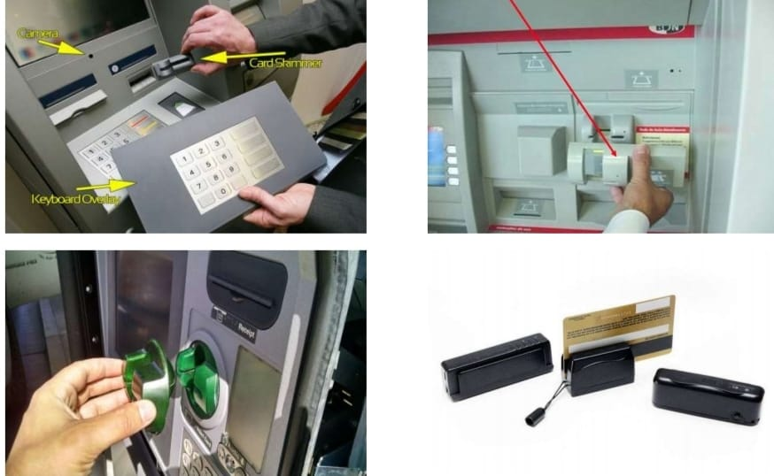
PROBLEM IDENTIFICATION
Card Skimming :
The scammers try to steal your card details so they can access your accounts. Once scammers have skimmed your card, they can create a fake or clone card with your details on it. The scammer is then able to run up charges on your account.

Slide 8
PROPOSED SYSTEM
1.Facial recognition:
Facial recognition can be used to identify the customer, allowing them to access their account without the need for a physical ATM card. This could improve security by reducing the chances of fraud and theft.
2.Gesture recognition:
Gesture recognition can allow customers to interact with the ATM machine using hand gestures, eliminating the need for physical buttons. This could improve hygiene and reduce the spread of germs, especially during a pandemic.

Slide 9
PROPOSED SYSTEM
3.Object recognition:
Object recognition can be used to detect skimming devices or other unauthorized modifications to the ATM machine, alerting security personnel and preventing fraudulent activity.
4. Image-based deposit verification:
Customers can use the ATM machine to deposit checks or cash, and computer vision techniques can be used to verify the authenticity of the deposit.

Slide 10
PROPOSED SYSTEM
5.Queue management:
Computer vision techniques can be used to monitor the number of customers waiting in line and estimate the time it will take to serve them. This information can be used to optimize the operation of the ATM machine and improve the customer experience.
6.Real-time security monitoring:
Computer vision techniques can be used to monitor the ATM machine and surrounding area in real-time, alerting security personnel to any suspicious activity.

Slide 11
REQUIREMENTS
HARDWARE REQUIREMENT
SOFTWARE REQUIREMENT
Processor : Processor Intel CORE i3
RAM : 4 GB
Internet Connection : 20 mbps
Operating System : Windows, Mac, Linux
Language : Python 3.7 (opencv)

Slide 12
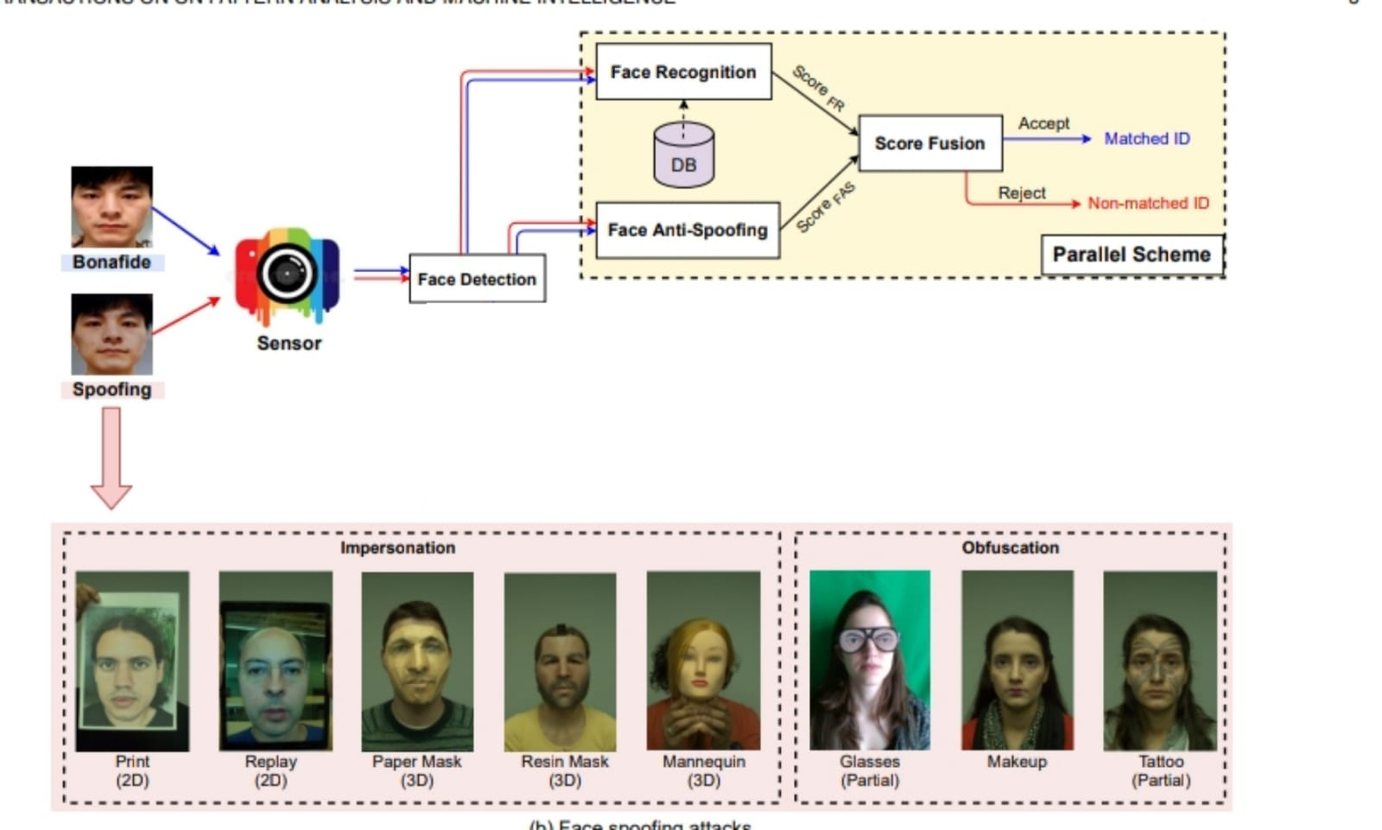
BLOCK DIAGRAM

Slide 13
MODULE EXPLANATION
1.Face Recognition:
Face recognition technology is used to identify the user before allowing access to the ATM machine. The user's face is captured using a camera and matched against a database of known faces to verify their identity.
2.Object Detection:
Object detection techniques are used to identify any suspicious objects or movements near the ATM machine. This can help prevent theft or vandalism.

Slide 14
MODULE EXPLANATION
3.Motion Detection:
Motion detection algorithms are used to detect liveness of a human and any unusual movements near the ATM machine.
4.Fraud Detection:
Machine learning algorithms are used to analyze user behavior and identify any suspicious activity, such as multiple failed login attempts or unusually large withdrawals.

Slide 15
HAAR CASCADE ALGORITHM
It is an Object Detection Algorithm used to identify faces in an image or a real time video. The algorithm uses edge or line detection features proposed by Viola and Jones in their research paper “Rapid Object Detection using a Boosted Cascade of Simple Features” published in 2001. The algorithm is given a lot of positive images consisting of faces, and a lot of negative images not consisting of any face to train on them. The model created from this training is available at the OpenCV GitHub repository.

Slide 16
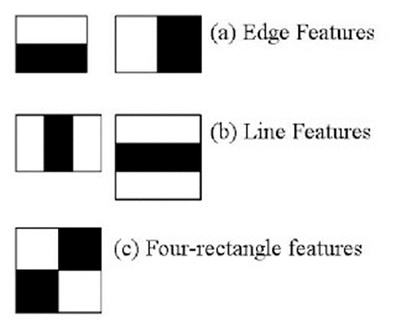
HAAR CASCADE FEATURES
The first set of two rectangle features are responsible for finding out the edges in a horizontal or in a vertical direction (as shown below). The second set of three rectangle features are responsible for finding out if there is a lighter region surrounded by darker regions on either side or vice-versa. The third set of four rectangle features are responsible for finding out change of pixel intensities across diagonals.

Slide 17
HAAR CASCADE FEATURES
The objective here is to find out the sum of all the image pixels lying in the darker area of the haar feature and the sum of all the image pixels lying in the lighter area of the haar feature. And then find out their difference. Now if the image has an edge separating dark pixels on the right and light pixels on the left, then the haar value will be closer to 1. That means, we say that there is an edge detected if the haar value is closer to 1. In the example above, there is no edge as the haar value is far from 1.

Slide 18

SAMPLE INPUT & OUTPUT
STEP 1 : ENTER ACCOUNT DETAILS

Slide 19
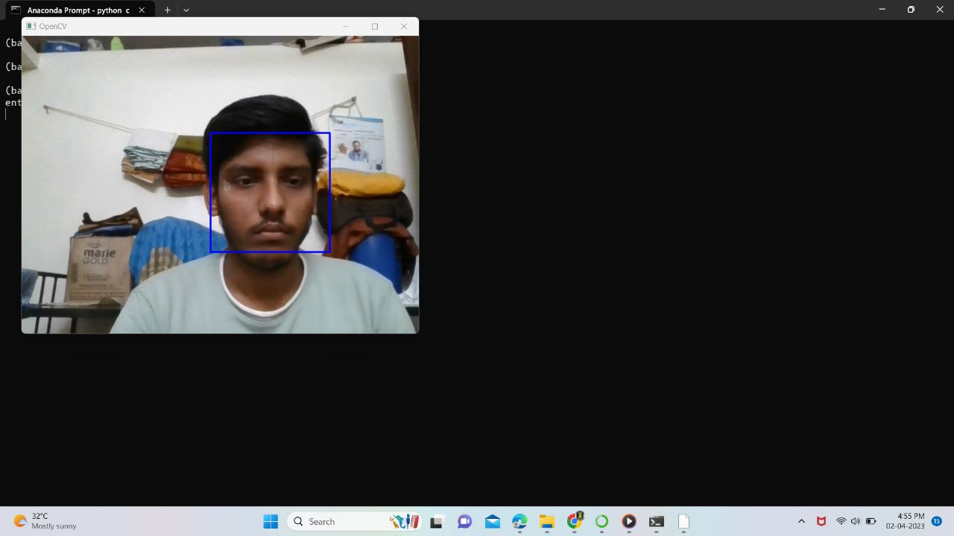
SAMPLE INPUT & OUTPUT
STEP 2 : FACE DETECTION USING HAAR CASCADE

Slide 20
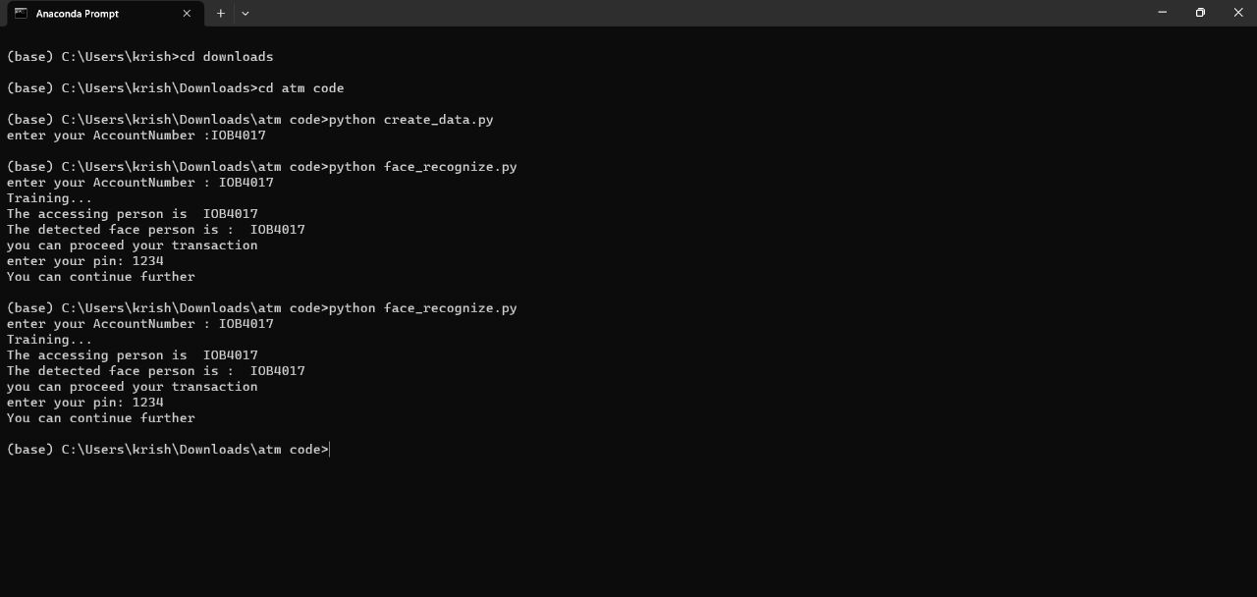
SAMPLE INPUT & OUTPUT
STEP 3 : PROCEED TO TRANSACTION

Slide 21
SAMPLE INPUT & OUTPUT
TRANSACTION HANDLED BY KNOWN PERSON
STEP 1 : ENTER ACCOUNT DETAILS

Slide 22
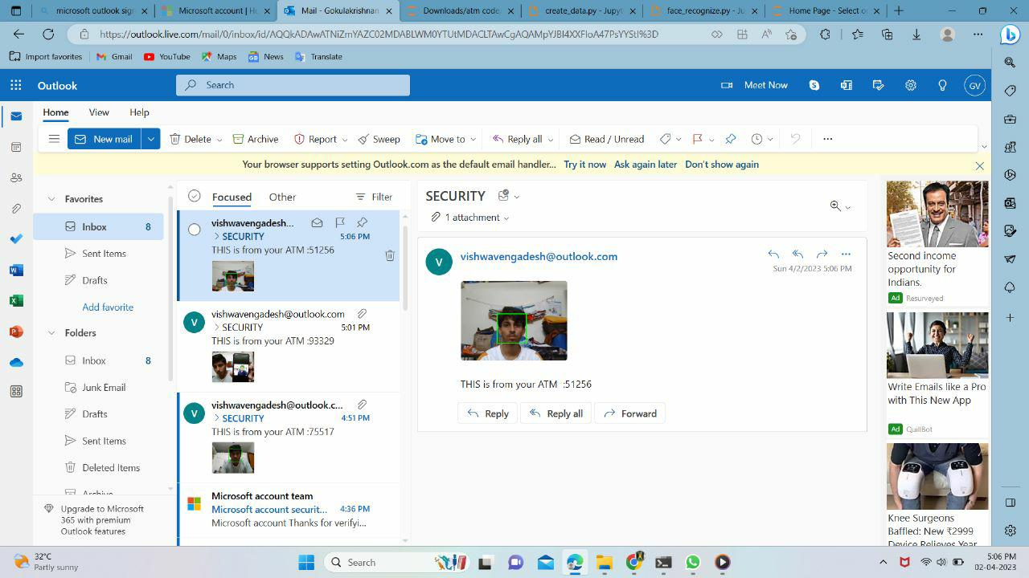
SAMPLE INPUT & OUTPUT
STEP 2 : VERIFICATION KNOWN PERSON

Slide 23
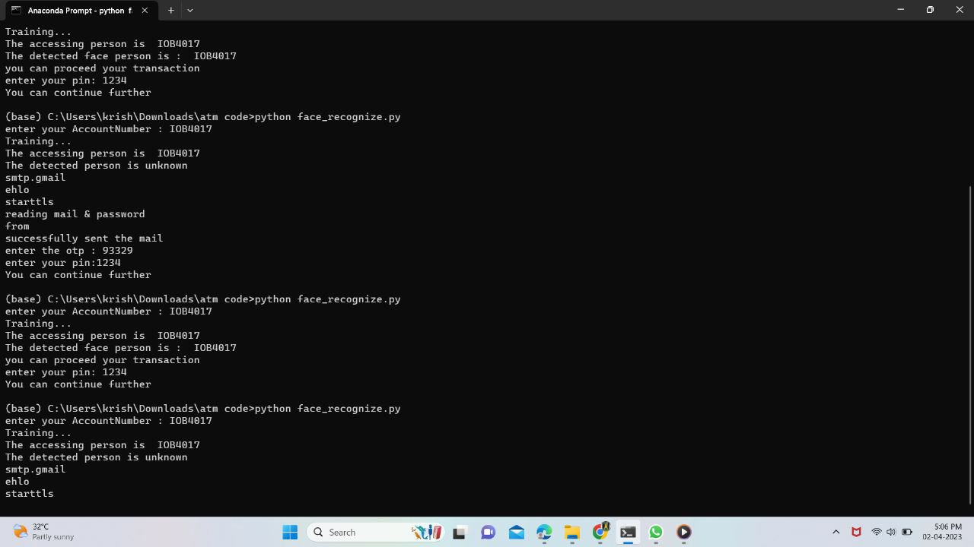
SAMPLE INPUT & OUTPUT
STEP 3 : ACCESSING KNOWN PERSON

Slide 24
RESULT & DISCUSSION
Using face recognition technology for ATM machine access is a promising approach to enhance security and convenience. In this project, we utilized the Haar Cascade algorithm to detect and recognize the faces of authorized users, allowing them to access their account without the need for a physical card.
The project result showed that the Haar Cascade algorithm was successful in detecting and recognizing faces with a high level of accuracy. We trained the algorithm using a large dataset of facial images to improve its recognition performance. The trained model was then integrated into the ATM machine, allowing users to access their accounts by simply looking at the camera.
The benefits of this approach include increased security, as it eliminates the risk of unauthorized access by stolen or lost cards, and convenience, as users no longer need to carry physical cards. It also reduces the risk of transmission of pathogens through physical contact with the ATM machine.

Slide 25
CONCLUSION
This project is aimed to reduce the risk involved in ATM machines that were installed in remote area, also the issue related to fraudulent transaction like misusing others card to withdraw money and etc.
So in order to overcome these challenges, we have developed solution that will leverage the ML & AI to restrict card access to only the authorized users those are identified by face recognition algorithm.

Slide 26
REFERENCE
I. Banerjee, S. Mookherjee, S. Saha, S. Ganguli, S. Kundu and D. Chakravarti, "Advanced ATM System Using Iris Scanner," 2019 International Conference on Opto-Electronics and Applied Optics (Optronix), Kolkata, India, 2019, pp. 1-3.doi: 10.1109/OPTRONIX.2019.8862388
S. Sankhwar and D. Pandey, "A Safeguard against ATM Fraud," 2016 IEEE 6th International Conference on Advanced Computing (IACC), Bhimavaram, India, 2016, pp. 701-705.doi: 10.1109/IACC.2016.135
Y. Cheng, W. Shang, L. Zhu and D. Zhang, "Design and implementation of ATM alarm data analysis system," 2016 IEEE/ACIS 15th International Conference on Computer and Information Science (ICIS), Okayama, Japan, 2016, pp. 1-3.doi: 10.1109/ICIS.2016.7550948
C. Porretti, R. Lahaije and D. Kolev, "A New Vision for ATM Security Management: The Security Management Platform," 2016 11th International Conference on Availability, Reliability and Security (ARES), Salzburg, Austria, 2016, pp. 493-498. doi: 10.1109/ARES.2016.50
H. R. Babaei, O. Molalapata and A. A. Pandor, Face Recognition Application for Automatic Teller Machines (ATM), in ICIKM, 3rd ed. vol.45, pp.211-216, 2012.
Aru, O. Eze and I. Gozie, Facial Verification Technology for Use in ATM Transactions, in American Journal of Engineering Research (AJER), [Online] 2013, pp. 188-193, Available:http://www.ajer.org/papers/v2 (5)/Y02501880193.pdf ← K.

